Slide 1


HOLY MARY INSTITUTE OF TECHNOLOGY & SCIENCE (Approved by AICTE, New Delhi, Affiliated to JNTU, Hyderabad)
BOGARAM(V),KEESARA(M),MEDCHAL DISTRICT-501301
2021-2022
DEPARTMENT OF COMPUTER SCIENCE ENGINEERING
FAKE NEWS DETECTION
By:
P. Vijayalaxmi (18C91A0568)
P. Adithya Ram(18C91A0573)
Rahul Singh(18C91A0578)
Under the guidance of
Name: Dr. B. Devender M.Tech,Ph.D
Professor

Slide 2
ABSTRACT
Internet is one of the important inventions and a large number of persons are its users. These persons use this for different purposes. There are different social media platforms that are accessible to these users. Any user can make a post or spread the news through these online platforms.
Fake News has become one of the major problems in the existing society. Fake News has high potential to change opinions, facts and can be the most dangerous weapon in influencing society. The proposed project uses NLP techniques for detecting the 'fake news', that is, misleading news stories which come from the non-reputable sources. By building a model based on a K-Means clustering algorithm, the fake news can be detected. The data science community has responded by taking actions against the problem. It is impossible to determine a news as real or fake accurately. So, the proposed project uses the datasets that are trained using count vectorizer method for the detection of fake news and its accuracy will be tested using machine learning algorithm

Slide 3
PROBLEM STATEMENT
News consumption is a double-edged sword. It enables the wide spread of “fake news”, i.e., low quality news with intentionally false information. The extensive spread of fake news has the potential for extremely negative impacts on individuals and society. Therefore, fake news detection has recently become an emerging research that is attracting tremendous attention. First, fake news is intentionally written to mislead readers to believe false information, which makes it difficult and nontrivial to detect based on news content. To develop a FAKE NEWS DETECTION system using natural language processing and its accuracy will be tested using machine learning algorithms. The algorithm must be able to detect fake news in a given scenario world.

Slide 4
EXISTED SYSTEM :
Rubin, and Chen outlines several approaches that seem promising towards the aim of perfectly classify the misleading articles. They note that simple content-related n-grams and shallow parts-of-speech (POS) tagging have proven insufficient for the classification task, often failing to account for important context information. Rather, these methods have been shown useful only in tandem with more complex methods of analysis. Deep Syntax analysis using Probabilistic Context Free Grammars (PCFG) have been shown to be particularly valuable in combination with n-gram.

Slide 5
PROPOSED SYSTEM :
The proposed system when subjected to a scenario of a set of news articles , the new articles are categorized as true or fake by the existing data available. This prediction is done by using the relationship between the words used in the article with one another. The proposed system contains a Word2Vec model for finding the relationship between the words and with the obtained information of the existing relations , the new articles are categorized into fake and real news.

Slide 6
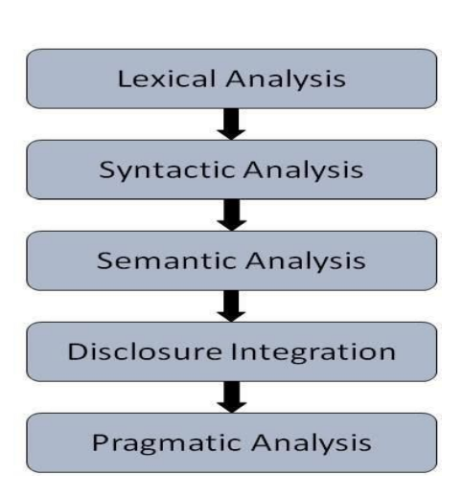
NATURAL LANGUAGE PROCESSING
NLP is an area of computer science and artificial intelligence concerned with the interactions between computers and human (natural) languages, in particular how to program computers to fruitfully process large amounts of natural language data.
NLP is an area of computer science and artificial intelligence concerned with the interactions between computers and human (natural) languages, in particular how to program computers to fruitfully process large amounts of natural language data.

Slide 7
DESIGN GOALS
To make the project runs smoothly it’s required that we make plan and design some accepts like flowcharts and system architecture which are defined below
Data Collection : Data collection is one of the important and basic thing in our project. The right dataset must be provided to get robust results. We will be taking and analyzing data from Kaggle. After that seeing the accuracy we will use the data in our model.
Data Preprocessing : Human can understand any type of data but machine can’t our model will also learn from scratch so it’s better to make the data more machine readable. Raw data is usually inconsistent or incomplete .Data preprocessing involves checking missing values, splitting the dataset and training the machine etc.
Training Model : Similar to feeding somethings, machine/model should also learn by feeding and learning on data. The data set extracted from Kaggle will be used to train the model. The training model uses a raw set of data as the undefined dataset which is collected from the previous fiscal year and from the same dataset a refine view is presented which is seen as the desired output. For the refining of the dataset various algorithms are implemented to show the desired output.

Slide 8
SOFTWARE REQUIREMENTS :
Operating system : Windows 10.
Coding Language : Python
Python 3.5 in Google Colab is used for data pre-processing, model training and prediction.
HARDWARE REQUIREMENTS :
System : Intel i3Core.5th gen
RAM : 4 GB
Storage : 500 GB
CPU : 2 GHz or faster
Architecture : 32-bit or 64-bit

Slide 9
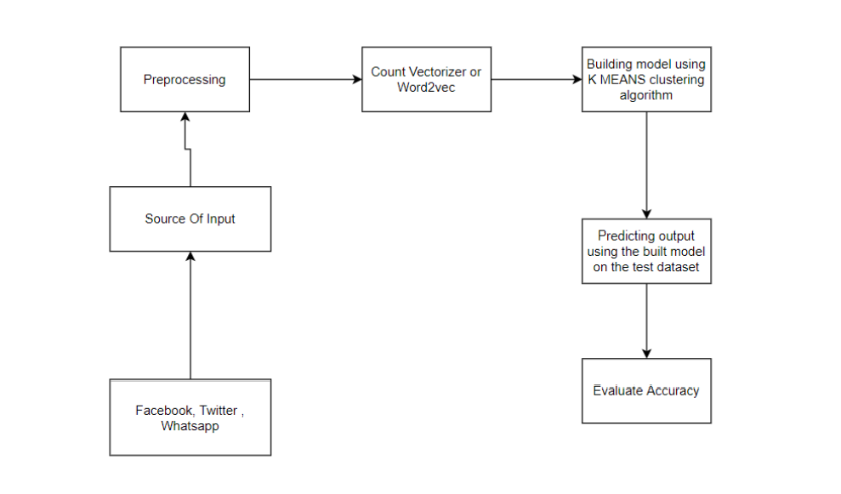
SYSTEM ARCHITECTURE

Slide 10
Input is collected from various sources such as newspapers, social media and stored in datasets. System will take input from datasets. The datasets undergo preprocessing and the unnecessary information is removed from it and the data types of the columns are changed if required. Jupyter notebook and python libraries are used in the above step. Count vectorizer technique is used in the initial step. For fake news detection, we have to train the system using dataset. Before entering to the detection of fake news, entire dataset is divide into two datasets. 80% is used for training and 20% is used for testing. During training, K-Means algorithm is used to train the model using the train dataset. In testing, the test dataset is given as input and the output is predicted. After the testing time, The predicted output and the actual output are compared using confusion matrix obtained. The confusion matrix gives the information regarding the number of correct and wrong predictions in the case of real and fake news. The accuracy is calculated by the equation No Of Correct Predictions/Total Test Dataset Input Size

Slide 11
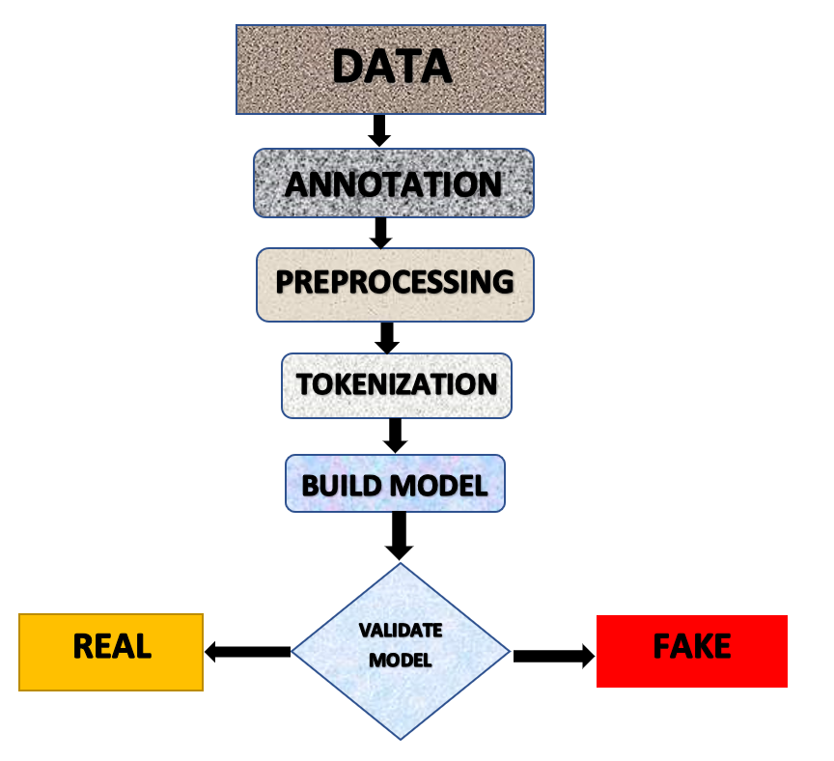
DATA FLOW DAIGRAM

Slide 12
ADVANTAGES
Its low cost.
Easy access, and rapid dissemination of information lead people to seek out and consume news from social media.

Slide 13
IMPLEMENTATION
Step 1: Start
Step 2: Input is collected from various sources and prepare a dataset.
Step 3: Preprocessing of data is done and dataset is divided into 2 parts training and testing data.
Step 4: Count vectorization technique is used to convert the train data into numerical.
Step 5: K MEANS clustering algorithm is used to build the predictive model using the train data.. Step 6: Confusion matrix is obtained.
Step 7: Accuracy is calculated y.

Slide 14
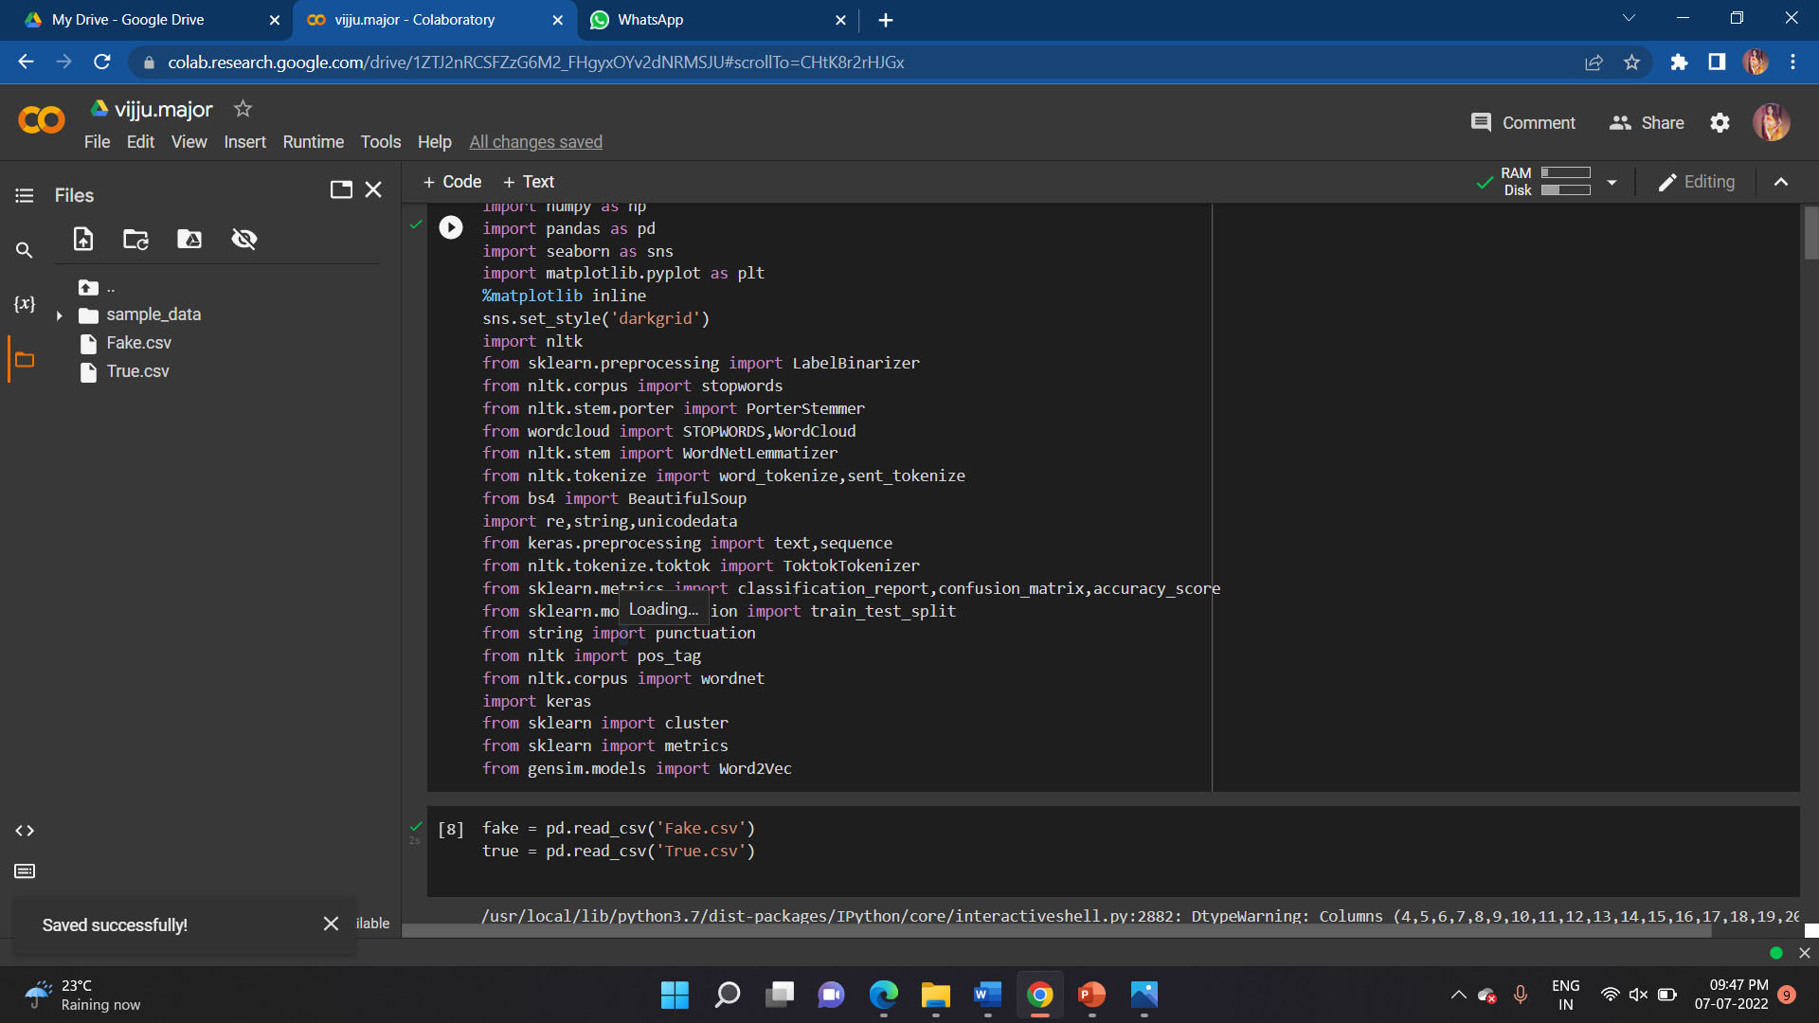
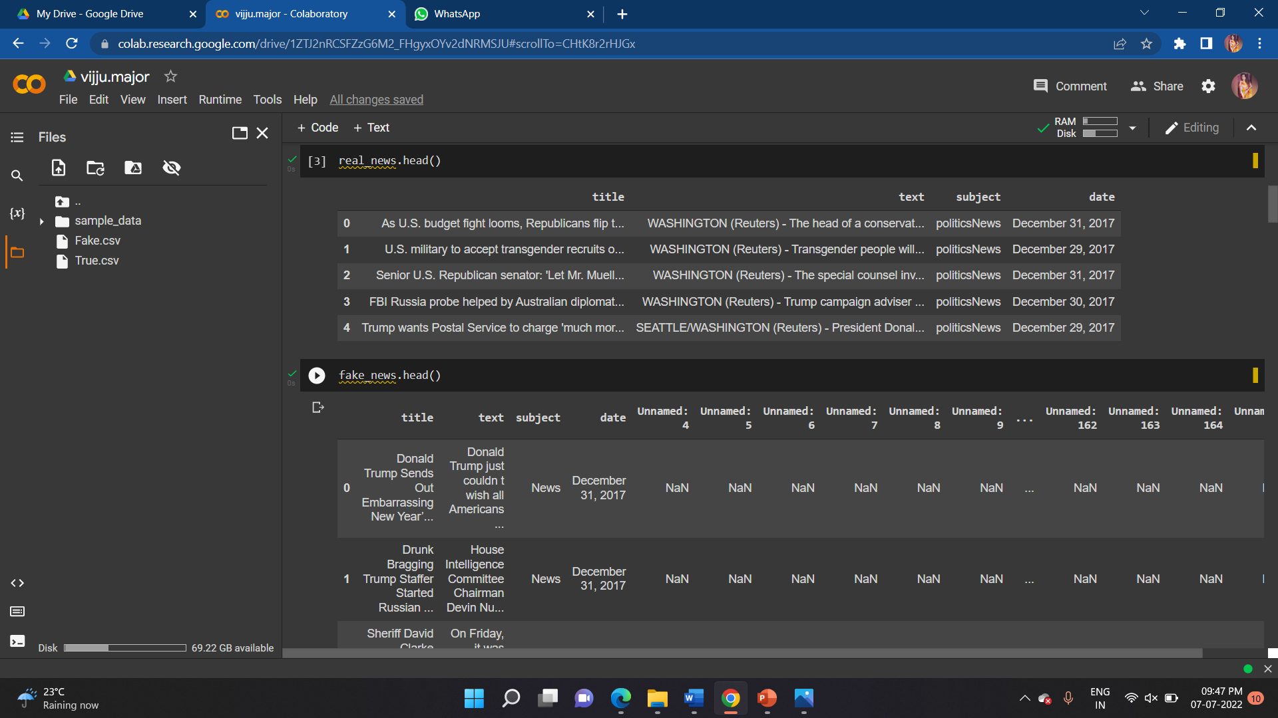
SCREENSHOTS

Slide 15
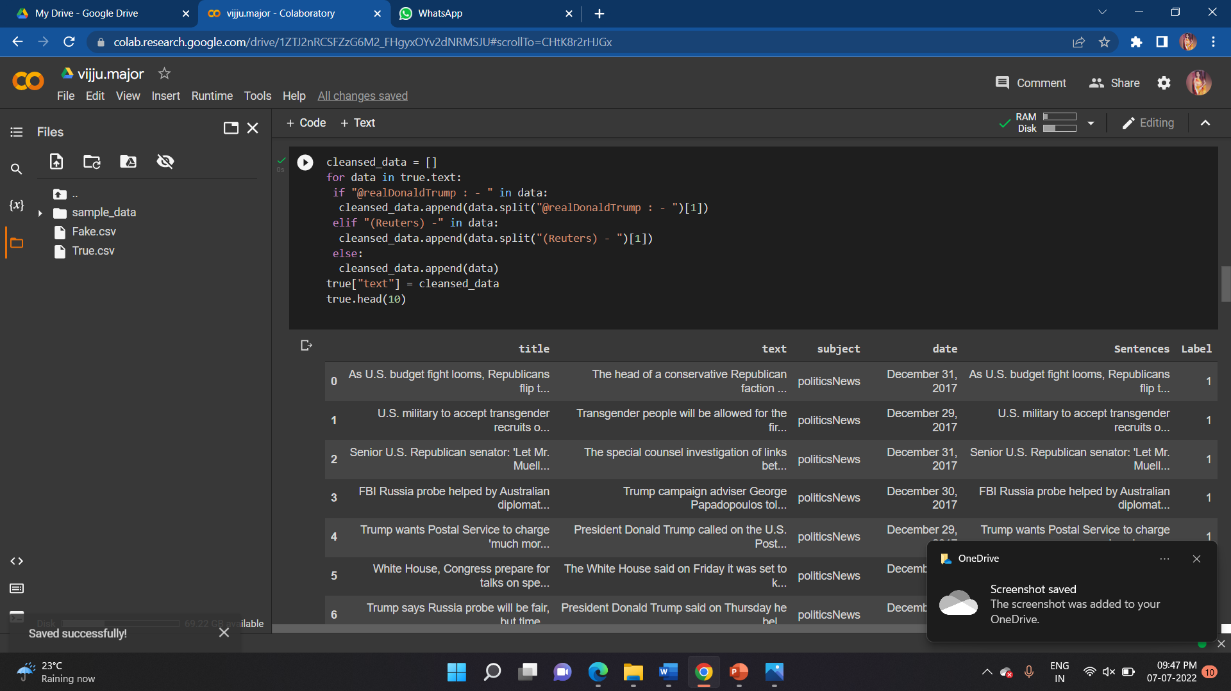
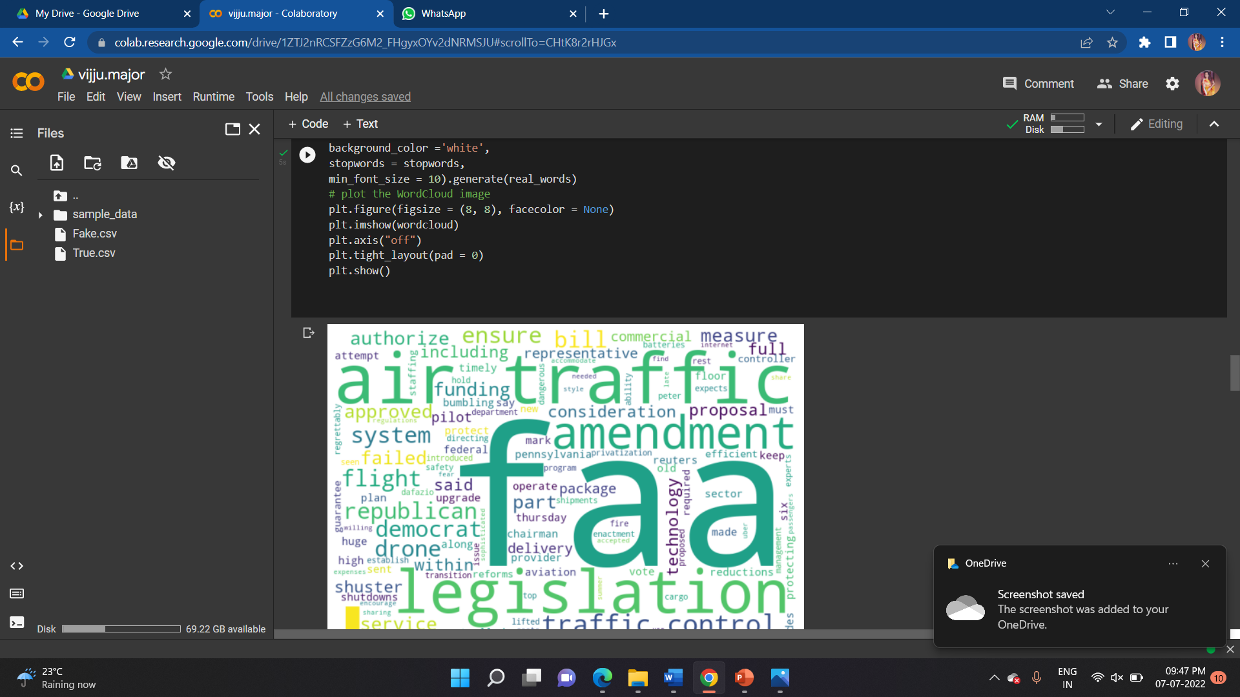
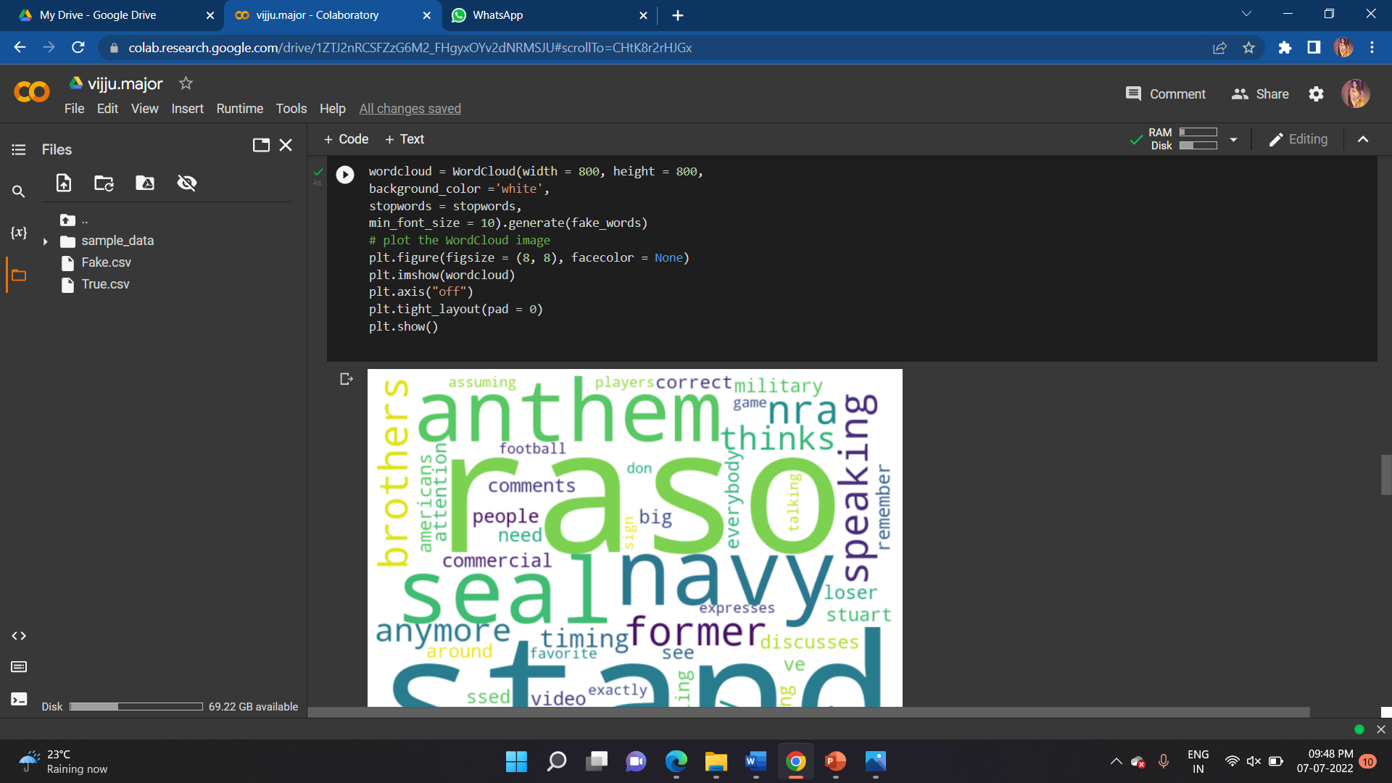
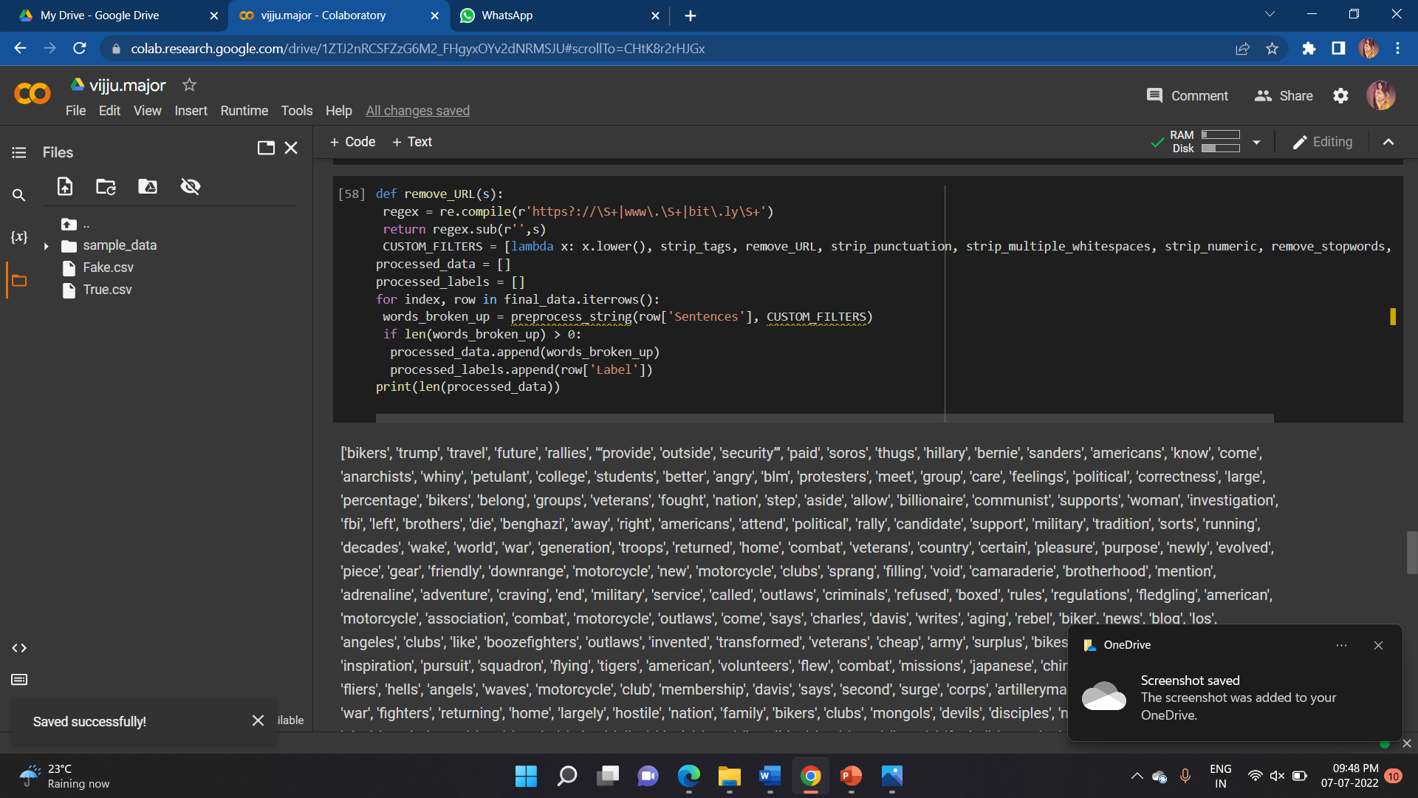

Slide 16
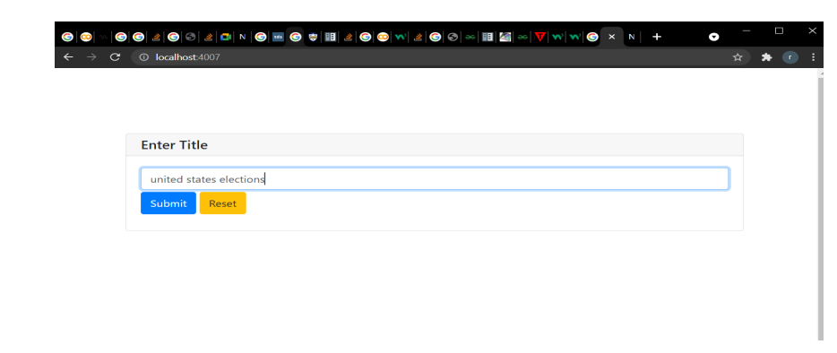
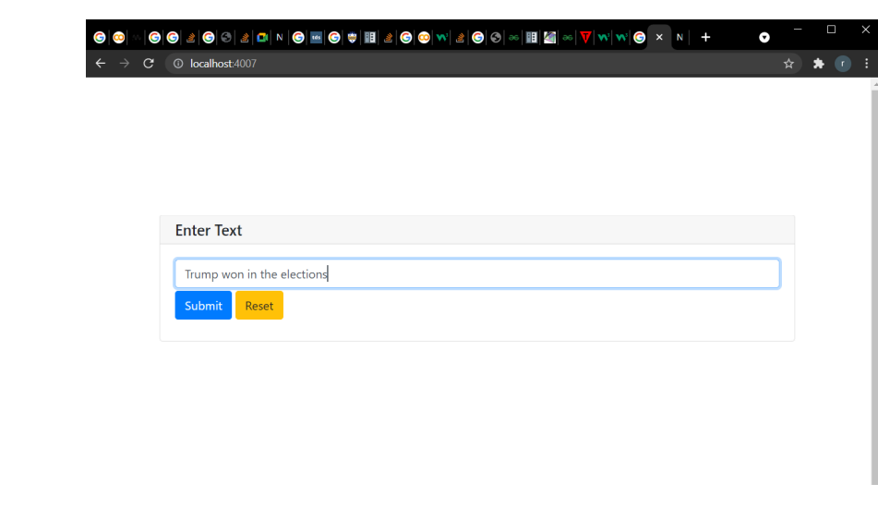
SCREENSHOT
USER INPUT
Enter the title Enter the text

Slide 17
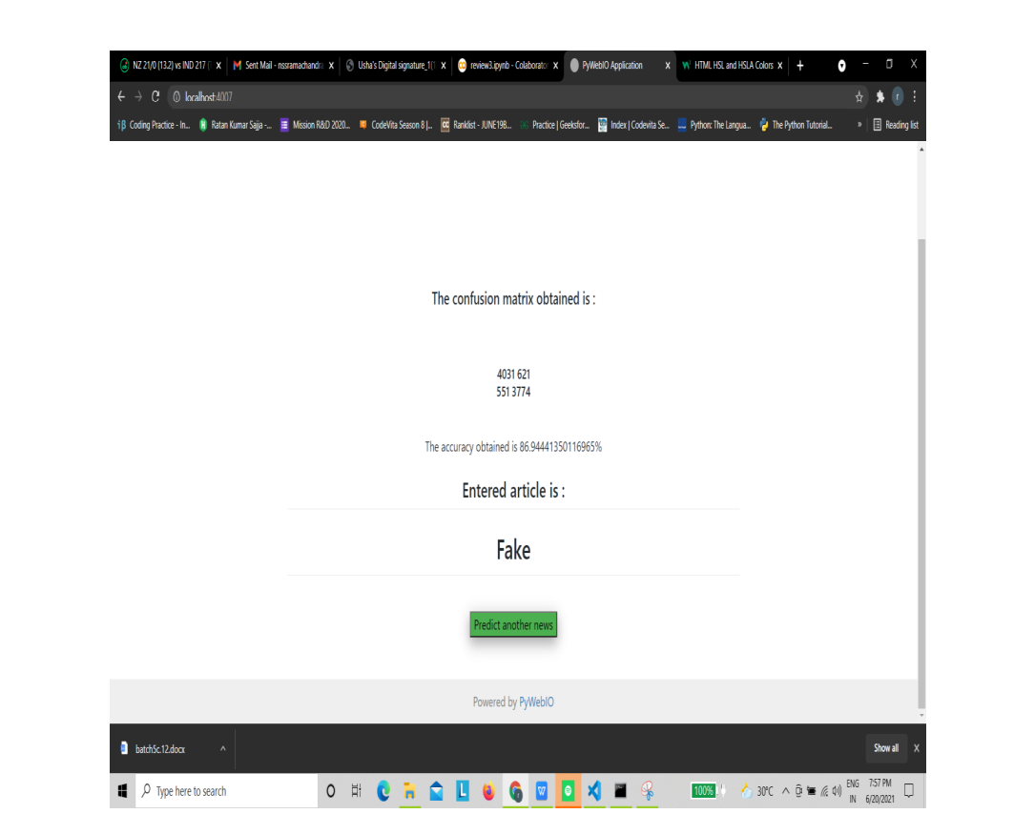
OUTPUT

Slide 18
CONCLUSION
In this project , we are predicting whether an article is a real or fake article based on the relationship between the words . We have used some datasets for creation of this system . We used Word2Vec model for building model and K -Means for the prediction and obtained an accuracy of 87%.

Slide 19
FUTURE WORK
We want to use web scraping and get the data from various social media and websites by ourself and use them in our system.
We also want to improve the accuracy by query optimization.

Slide 20


